Slide 1
Price Prediction for Airbnb Listings in San Francisco
Yavuz Dagdas, PhD
Data Science Career Track Capstone Project, December 2020 Cohort
Springboard Mentor
Blake Arensdorf

Slide 2
The Problem
The Problem
No freely available tool for Airbnb hosts to determine the price for their listings
Unable to optimize pricing for the listings, both Airbnb hosts and Airbnb could loose potential revenue
Who might be interested
Airbnb Hosts
Airbnb

Slide 3
The Data Information
The Data Information
Data scraped from Airbnb website on 03-02-2021
6882 listings within San Francisco with 73 attributes
Data downloaded from Inside Airbnb open data source
http://insideairbnb.com/

Slide 4
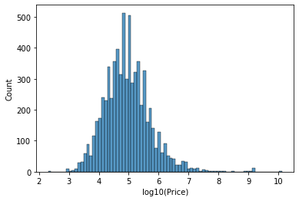
Exploratory Data Analysis
Prices for Airbnb listings range from $10 per night to $25000 per night

Slide 5
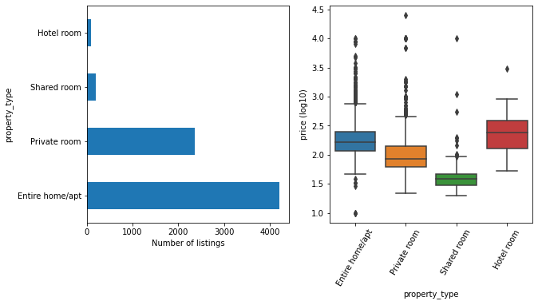
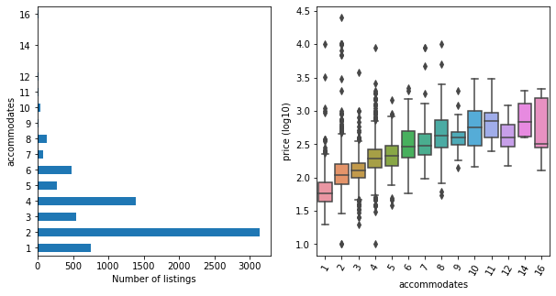
Exploratory Data Analysis
Entire home/apartments consist the majority of listings and listing price increases with the accommodation limit

Slide 6
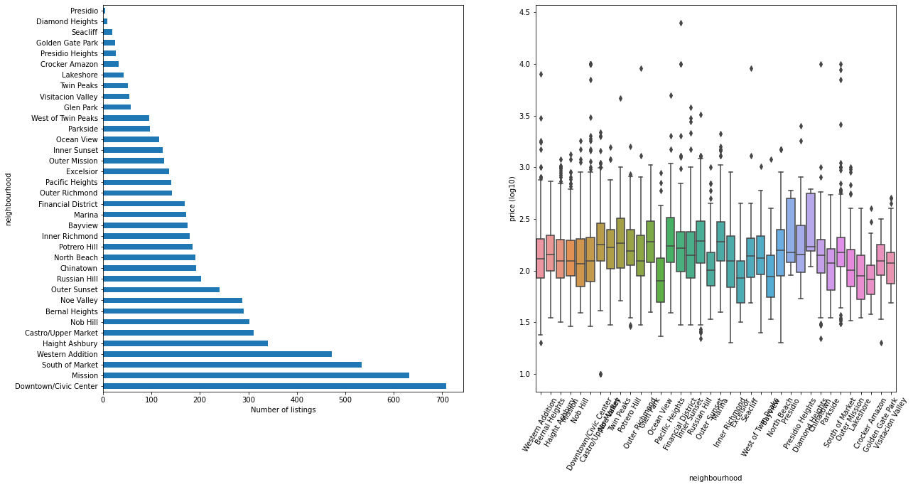
Exploratory Data Analysis
The price of listings are similar among the neighborhoods of San Francisco

Slide 7
Machine Learning Model
Supervised Learning, Regression, scikit-learn
Modeling Steps:
Data pre-processing steps:
Dummy encoding of the categorical variables
Standardization and Normalization (MinMax Scaler) of the data
Data is split into training and test data (80% – 20%)
There regression model is tested (Linear, Random Forest, XGBoost Regressor)
Cross-validation & hyper-parameter tuning:
5-fold cross-validation
Using GridSearchCV of scikit-learn
Evaluation metric: R-squared
Training the model using optimized parameters
Removal of outliers from dataset
Filtered out listings using target column (lower and upper 2.5%)
Performance evaluation on test dataset

Slide 8
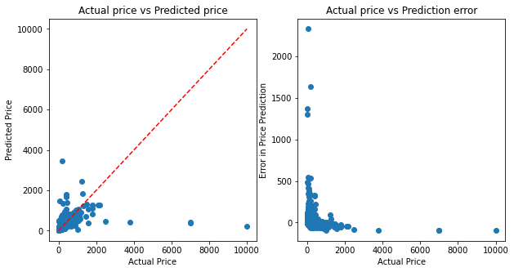
Model Comparisons – First Run
Model | Training Data (R-squared) | Test Data (R-squared)
Linear Regressor | 0.11 | 0.02
XGBoost Regressor | 0.99 | -0.02
Random Forest Regressor | 0.92 | 0.11
Descriptive statistics for
price_per _accommodate
% error is huge for lower price range
Cross-validation revealed that R-squared value for some folds are negative
Presence of outliers cause model to perform poorly.
% error = (actual price-predicted price)/(actual price)

Slide 9
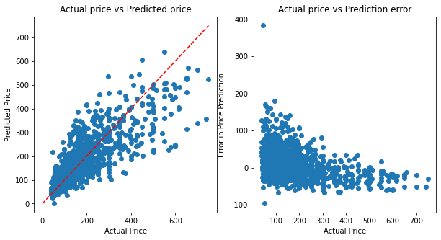
Model Comparisons – Outliers Removed
Model | Training Data (R-squared) | Test Data (R-squared)
Linear Regressor | 0.53 | 0.54
XGBoost Regressor | 0.94 | 0.66
Random Forest Regressor | 0.95 | 0.65
Model performance improved significantly after outliers removed
Prediction error is bigger for the low price range

Slide 10
Optimization of Model for Price Range
The model predicts the prices of listings in the low price range higher, and vice versa.
Can we improve the model performance if we divide the data frame with respect to price of the listings and optimize model for each segment?
Divide the data frame based on listing price
What is the threshold price for dividing the data?
Bin the % Error using price of the listing
Investigate %Error distribution
Divide the data into two
Training the model using optimized parameters
Performance evaluation on test dataset
& Cross-validation & hyper-parameter tuning:
5-fold cross-validation
Using GridSearchCV of scikit-learn
Evaluation metric: R-squared

Slide 11
Optimization of Model for Price Range
Model | Training Data (R-squared) | Test Data (R-squared)
Price more than $200 | 0.78 | 0.29
Price less than $200 | 0.88 | 0.65
Combined | 0.85 | 0.67
Small size of the dataset that contains listing more than $200 is likely reason of the poor performance of the model
~$200 the distribution of %Error shifts from positive to negative

Slide 12
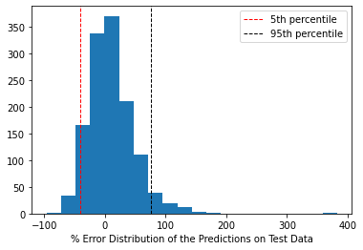
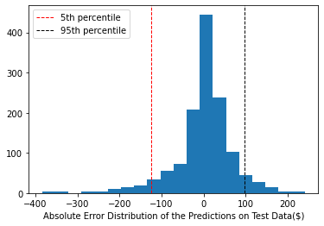
Model Evaluation
XGBoost Regressor model trained with complete dataset has R-squared: 0.66
% Error = 100 * (predicted price – actual price) / actual price
Absolute Error = predicted price - actual price
% Error Distribution
Absolute Error Distribution
Two scenarios are created to asses the business value of the model

Slide 13
Scenario 1
Inexperienced new host would more likely to determine listing price based on couple of features:
Number of bedrooms
Number of beds
Number of people a listing can accommodate
Location
Our model utilizes >100 features to predict the price. Let’s compare the mean absolute error of our model and a new model that uses only these attributes:
Dataset | R-squared | Mean Absolute Error ($)
Original | 0.66 | 26.9
Limited | 0.34 | 50.8
Our model has significantly better R-squared value and significantly less mean absolute error

Slide 14
Scenario 2
Our model is limited with the quality of the data. Our data does contain listings of all types of hosts. I hypothesize that there are 3 main types of hosts:
Companies/professional: These hosts follow the market trend and optimize the price of the listing to maximize revenue and occupancy and has multiple listings.
Residents of SF: These hosts live in SF and are willing to list their residence for only above market price or high price so that they could use the revenue for travelling somewhere else and has single listing.
New/Inexperienced: These host do not experience in Airbnb listings, could be listing their unit for low prices which provide high occupancy or high prices which cause low occupancy and has single listing.
What would be the model performance if it is only trained with the data of the hosts that are companies/professionals?

Slide 15
Scenario 2 - continued
Identify hosts that has 20 or more listings
Group by host id and filter hosts that have 20 or more listings.
Filter the dataset using these hosts.
Dataset | R-squared | Mean Absolute Error ($)
Original | 0.66 | 26.9
>20 | 0.90 | 6.9
<20 | 0.63 | 31.8
Train the model using on filtered dataset
The model has better performance when trained with the data (>20: listings of hosts that have 20 or more listing) that has better quality
Performance evaluation on test dataset
R-squared, mean absolute error
Train/evaluate on remaining listings and compare

Slide 16
Limitations & Ideas to Improve the Model
The size of dataset is small, it has only 6882 rows and it is limited by the number of the Airbnb listings.
The quality of the data, especially assessment of the list price by hosts:
Small portion of hosts have multiple units that are listed in Airbnb. These hosts do marketing research and adjust their prices.
New hosts that does not asses the market value due to inexperience and list the unit for significantly lower or higher amount.
Hosts that list their primary residence for only significantly high prices.
Airbnb listings in the other cities of San Francisco Bay Area can be joined to the dataset.
The location, and the distance of each listing to certain landmarks within the city could be included to the data to improve the signal.

Slide 17
Conclusions
Out of the 3 Supervised Regression Models XGBoost provided the best results.
Model can explain the 66% of the variance of the listing price.
The model predicts the prices of listings in the low price range higher, and vice versa.
Prediction error is bigger for the low price range.

